Slide 1
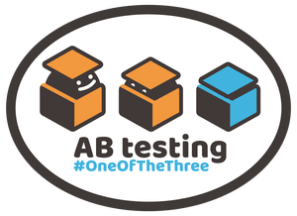

Modern Testing in Today’s World
@emna__ayadi
Notes:
Good morning ladies and gentlemen !
Before Starting, let me thank you all for being here today; a special thank to all IEEE committee organizers for such a great opportunity It’s good to see you all,
well I’m Emna Ayadi, a software tester at primatec,
I’m here today to provide you with an overview about modern testing
,

Slide 2

Y-
Test Engineer
Started my first job as a tester in 2015
Ministry of testing meetup organizer in Sfax
Gamification in Testing
IEEE Young Professional member
@emna__ayadi
2
Notes:
Test Engineer within Primatec Engineering, with more than 3 years of experience in software testing.
I’m passionate about testing
I got the chance to work in different fields of testing during my 3 years of experiences (mobile, web, desktop applications, automotive, ...).
I’m Ministry of Testing meetup organizer in Sfax and I’m curious about introducting gamification in testing for testers around me such as risk storming using test sphere that we will play today after the coffee break.
I joint IEEE recently as a young professional.
I’m here today to tell you what I discovered from modern testing and how modern testing is a baby born in our team when we move from scrum to extreme programming

Slide 3
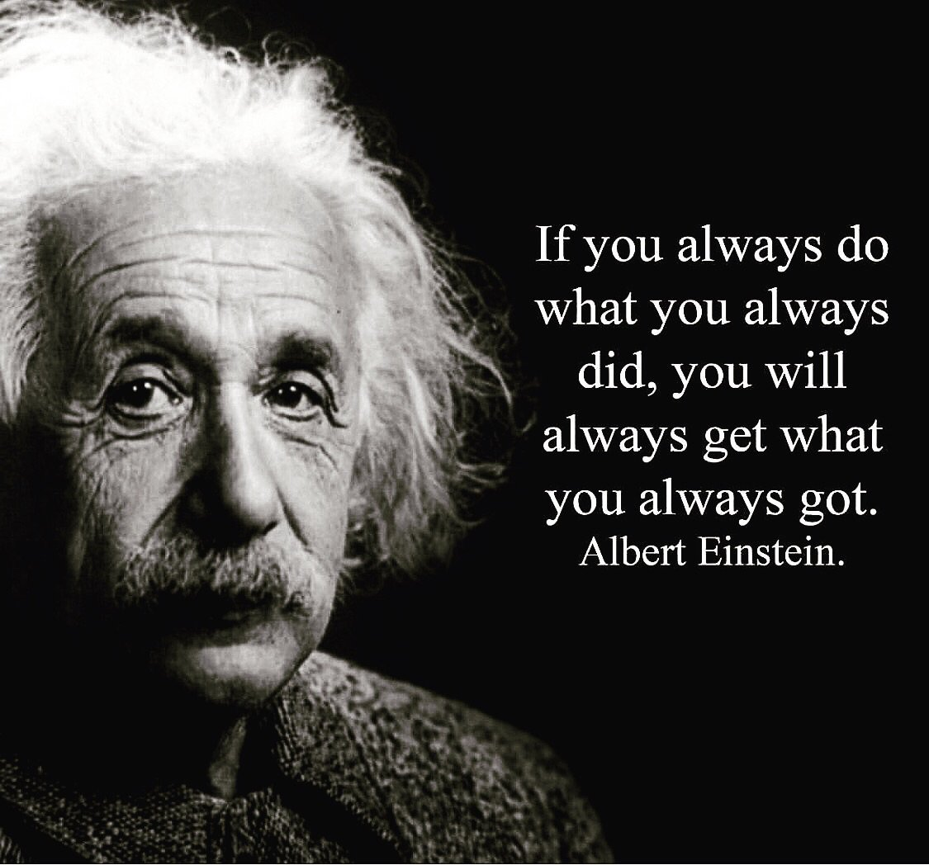


Notes:
I’ll start off by showing you the importance of making a change in our daily tasks
In fact, we are living in a world that changes rapidly and we need to adapt: it is all about delivering value to our customers and software is just of a way of delivering that value. Because it has to go rapidly we as testers don't want to be a bottleneck (as we were seen in the old, traditional time)

Slide 4
The evolution of the Test Role
4
Notes:
Testers are under heavy pressure to release applications more quickly and companies are pushing testers to make changes in their mindset from skill sets to coding to understanding how the business functions and dealing with customers. So testers must evolve !!
➔ We need to change otherwise we loose our job.
--

Slide 5
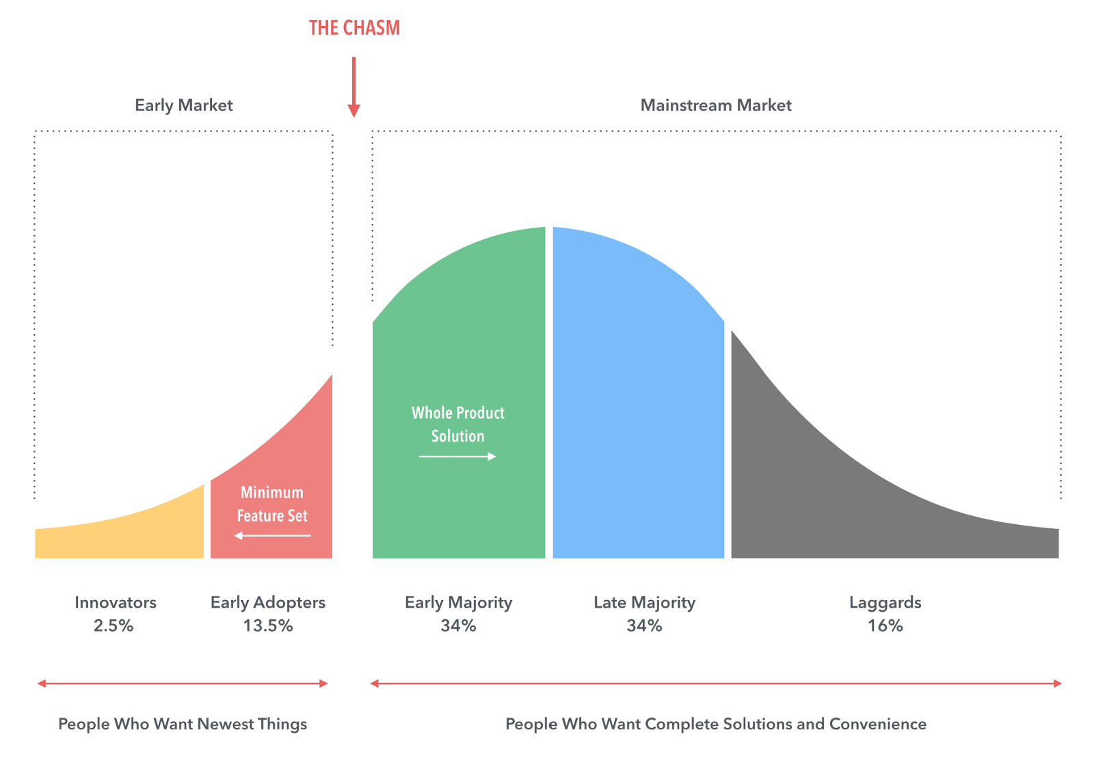
Crossing the Chasm
Notes:
I think we first need to identify this curve that you probably recognise it after that we will make the link with testing !
As you can see this model from crossing the chasm and diffusion of innovation curve probably familiar to most of you,
You have laggards you have the super early adapters or innovators and then you have most people living in here, like a tech crowd.
Think about people you know parents, friends some people already have the new iphone or the newest Android device, bunch of people are here with a fairly pretty recent phone, others really happy with their two year old phone that’s cool !, you have also friends using 20 year old model like blackberries phones

Slide 6
Photo By: Alan Page
6
Notes:
From the previous slide Alan Page linked the innovation curve with this testing curve
Modern testing is an evolution or adaptation of agile testing and as you can see modern testing belongs to people who wants newest things !

Slide 7
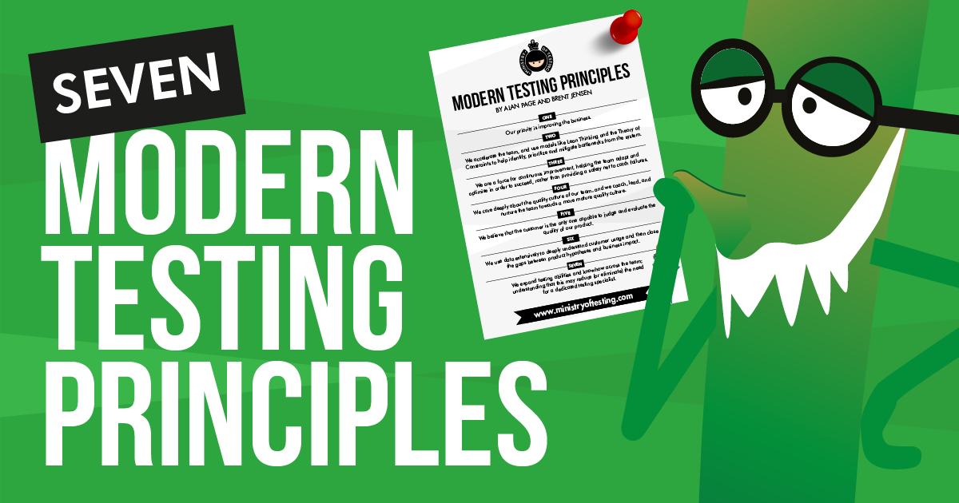

Plan
From Traditional to Modern Testing
What is Modern Testing ?
Modern Testing Mission
Introducing the Modern Tester
Quality Culture of the Team
7

Slide 8
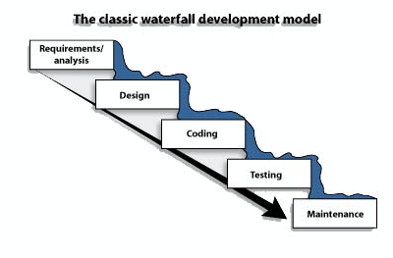
Problems faced with traditional testing
1
Separate Test team ➔ Conflicts with developers
2
Dependent on documentation
3
Requires excessive time and efforts
4
Developers can’t analyse tests & Testers don’t have enough knowledge about technical aspects
5
Focuses on code and specification correctness instead of quality
6
Testers are blamed when critical issues are found by customer
Notes:
Let’s see main problems that we discovered !
Here are different problem that testers and developers of my team have faced when using traditional methods
- We have separate test team
----------------------------------- http://www.professionalqa.com/traditional-testing-vs-agile-testing
Is mostly dependent on documentation.
Not enough knowledge about technical aspects

Slide 9
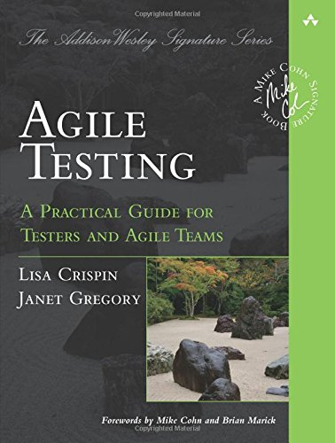

Agile Testing
1
Test Specialist on Feature Team
2
Works primarily on testing tasks needed for feature / product quality
3
Focus on test automation (90%)
9
Notes:
Let me move to what we call agile testing, I can mention the famous book of Lisa Crispn Agile Testing where you have the agile tester embedded in the agile team and they are the test specialists and they do all the testing for that feature very collaborative communications very critical on the agile team . Probably a lot of you are in this role and this scenario. You are the tester on agile team you’re helping the whole team move forward.
Primarily, your work is testing tasks, probably 90, 95 percent of your testing tasks is test automation that’s your role in the agile testing.
--------------------
http://www.professionalqa.com/traditional-testing-vs-agile-testing
Test Specialist on Feature Team
- Works primarily on testing tasks
needed for feature / product
quality

Slide 10

Transition to XP
10
Notes:
To answer this question, we can say that modern testing is an antidote for air quote traditional testing methods like testing at the very end of the product cycle, we test quality onto the product, separate fonctional test team
--
But how can we become modern testers ?

Slide 11

Why we are using eXtreme Programming ?
An Agile methodology
Short development life cycle
More flexible to change request
Improvment of quality
XP is used because :
Testing is Good
Write test first
Write tests that fail and then fix them (TDD)
11

Slide 12
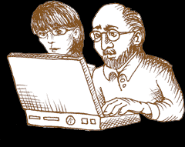
Why we are using eXtreme Programming ?
Code Review is Good
Review every line of code by ensuring that all code is written by programmers working in pairs
Integration is Good
Integrate as often as possible
Use tests to identify regressions
Pair programming
Planning game
The planning game is used to guide a product through to its delivery
12

Slide 13
Values of XP
Simplicity : Do what is needed and asked for, but no more
Communication : Everyone is part of the team and we communicate face to face daily
Feedback : We demonstrate our software early and often then listen carefully and make any changes needed.
Respect : Everyone gives and feels the respect they deserve as a valued team member.
Courage : Developers should have the courage to take fast decisions due to collective ownership and to tell the truth about the effort needed to complete tasks.
13

Slide 14
What Is Modern Testing ?
14
Notes:
we should learn, we should involve
we should make a kind of evolution from traditional to modern testing

Slide 15
Modern Testing is the Antidote for “Traditional”
Testing Methods
15
Notes:
To answer this question, we can say that modern testing is an antidote for air quote traditional testing methods like testing at the very end of the product cycle, we test quality onto the product, separate fonctional test team
--
But how can we become modern testers ?

Slide 16


Modern Testing Mission
Accelerate the Achievement of
Shippable Quality
16
Notes:
Modern Testing Mission
Accelerate the Achievement of
Shippable Quality

Slide 17

Introducing the
Modern Tester
13
Notes:
Some of you are agile testers some of you are somewhere in between. Some of you have been there a while, some of you are learning
I get inspired by the talk of Alan Page about modern testing and I discovered that our team members are on the road to become a modern tester
Alan & Brent have talked a about the new coming evolution which is Modern testing in their testing podcast.
A modern tester is a generalist who happens to be good at testing so it’s an evolution of the agile tester where they actually do a lot more things on the team but they’re good at they’re really good at testing. Just like you may have someone on your team who’s a performance expert or security expert or whatever that you need for the team that’s their role on the team they do a lot of different tasks but they’re kind of the GURU for testing concerned a lot with continuous improvement how de we improve how do we accelerate and a lot on customer value

Slide 18




We are On the Road to the Modern Tester …
Add value to the team
Focuses on accelerating the Team (Pairing with developers)
Generalizing Specialist (Be open to learning and change)
All team members are involved in testing
Workshops are provided during every new feature
Always getting feedback from customer
18
Notes:
I find out that I'm becoming modern tester and I already made some steps
(I'm on my journey to become a modern tester)
I'm inspired by the talk of Alan page because I'm looking for new development, here I find the context for my own story
So the modern tester helps the team move faster and use models like lean thinking and theory of constraints to help identify, prioritize and mitigate bottlenecks from the system,
What can also help moving the team faster is pair testing with developers and building good infrastructure and tooling
He is a coach he does some testing looks at data a lot and probably very close to what a lot of you do already
Specializing Generalist & Generalizing Specialist

Slide 19

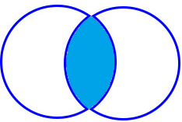
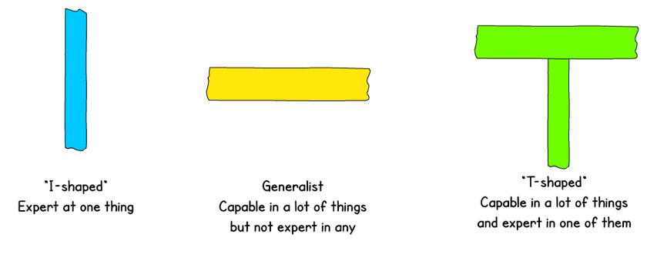
Specializing Generalist & Generalizing Specialist
The Magic
1
A T-shaped person is capable in many things and expert in, at least, one.
2
Creating a skills-matrix for t-shaped testers
3
T-shaped skills
Expert
Generalist
Generalist
Specialist
19
Notes:
https://en.wikipedia.org/wiki/T-shaped_skills
The concept of T-shaped skills, or T-shaped persons is a metaphor used in job recruitment to describe the abilities of persons in the workforce. The vertical bar on the T represents the depth of related skills and expertise in a single field, whereas the horizontal bar is the ability to collaborate across disciplines with experts in other areas and to apply knowledge in areas of expertise other than one's own.
http://katrinatester.blogspot.com/2014/04/test-strategy-retrospective.html

Slide 20
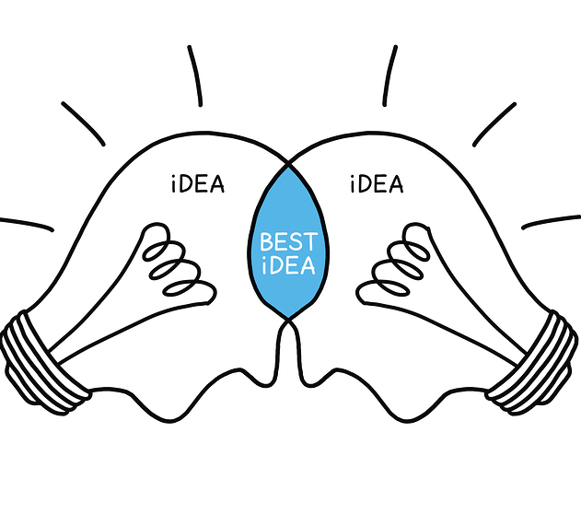
importance of collaboration
Collaboration leads to best practices and value for the organization
20

Slide 21
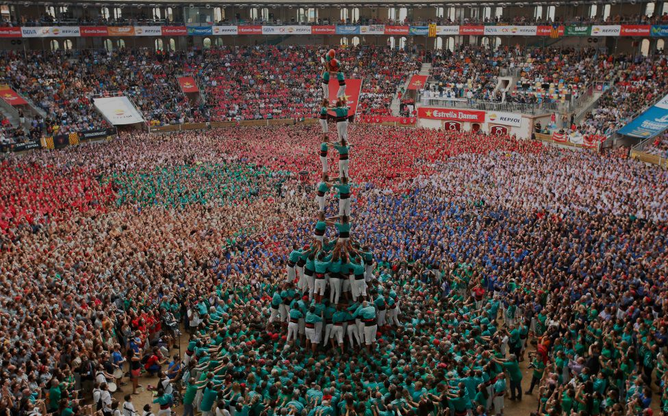
“Modern Testing is for Teams more than for Testers”
« Just as great football, great software comes from great collaboration »
Ingo Philip
« The strength of the team is in each individual member.
The strength of each member is the team »
Phil Jackson
21
21

Slide 22

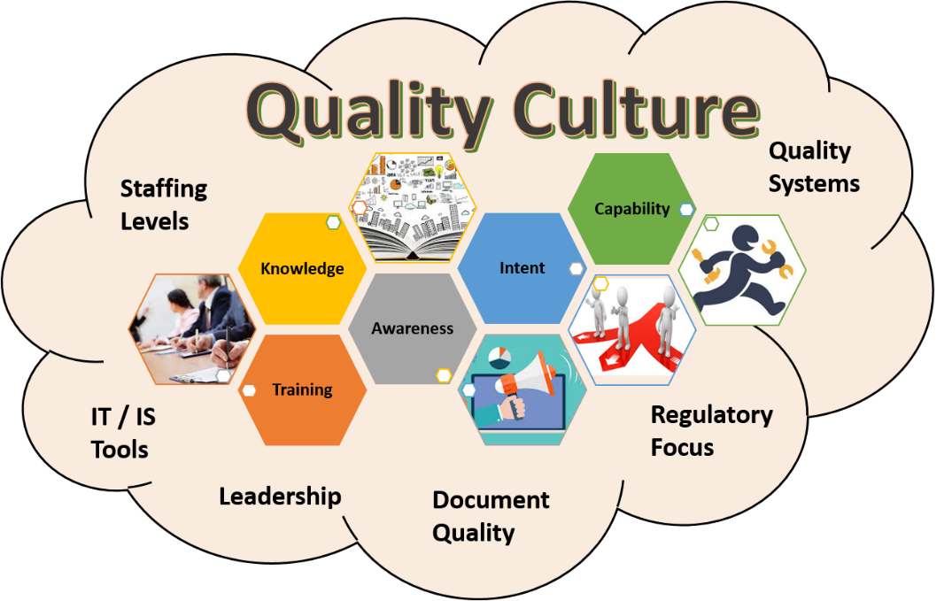
Conclusion
Photo By: Frontrowagile
1
Communication and collaboration between the whole team is improved
2
Helping (and coaching) the whole team test and making better software is a great role for many of those who are currently in a testing field
3
Developers can be good testers / test automators
Leadership
Quality Ownership
Breadth of Testing
Data Usage
Technical debt and maintenance
Code Quality and Tools
22
Notes:
I want to summarize
Playing the role of test coach and doing more coaching is a pretty helpful thing.

Slide 23

Thank You
About Modern Testing Principles
https://www.ministryoftesting.com/dojo/lessons/modern-testing-principles
The most up to date principles can always be found here
http://angryweasel.com/ABTesting
23

